Slide 1
DATA PRESENTATION
Presentation On
COVID-19 Trends
Presentation By
Bonventure Odhiambo
Msc Data Science
European Leadership University

Slide 2
Outline
1
Business Case on COVID-19
2
Data Profile
3
Trends on COVID 19 indicators
4
Conclusion

Slide 3
COVID-19 BACKGROUND
On March 11, 2020, the World Health Organization (WHO) declared the coronavirus disease 2019 (COVID-19) outbreak as a global pandemic.
Containment measures were put in place in most countries to limit or “contain” the spread or transmission of the COVID-19 virus.
These measures included lockdowns, quarantine, isolation, and cordon sanitaire.
As seen in several countries containment can be effective to prevent or reduce infections in the short-term but don’t necessarily work longer-term once movement and travel open up again.
This business case aims to understand the current worldwide COVID-19 trends in a bid to determine whether the containment measures and the vaccinations drive are effective or not.

Slide 4
DATA PROFILE
The global COVID-19 data was downloaded from kaggle at the URL: https://www.kaggle.com/datasets/carlaoliveira/country-data-on-covid19
The data was downloaded in CSV format and includes all historical data on the pandemic up to 03/01/2023, following a 1-line format per country and date.
The data included the following core variables: new cases, new deaths, total deaths, total cases, prevalence, incidence and vaccination ratio.
Line Charts and Bar graphs were used to show trends over time and for comparison of groups respectively.
Python was used to generate the graphs and charts. The matplotlib.pyplot.plot library was used for this assignment.

Slide 5
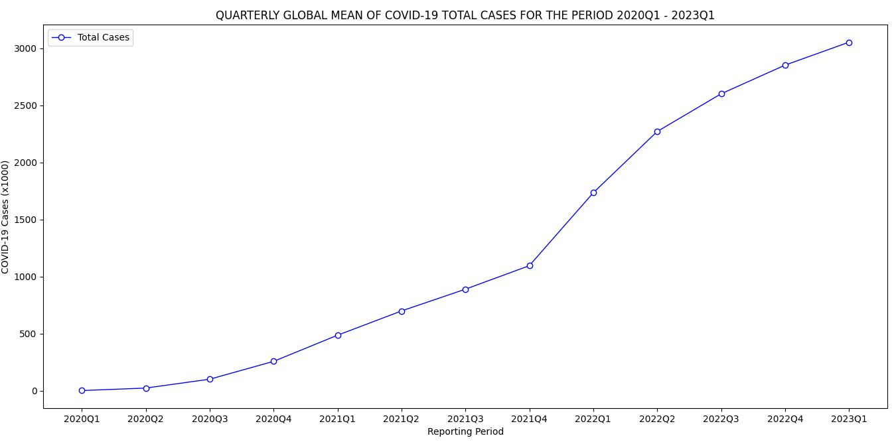
quarter | total_cases
2020Q1 | 1.73
2020Q2 | 23.52
2020Q3 | 101.08
2020Q4 | 257.42
2021Q1 | 486.42
2021Q2 | 698.77
2021Q3 | 889.58
2021Q4 | 1095.41
2022Q1 | 1734.09
2022Q2 | 2270.52
2022Q3 | 2600.9
2022Q4 | 2851.91
2023Q1 | 3052.71
The mean global COVID-19 cases have continued to increase from 2020 to date.
From a slightly low number of 1730 cases in the first quarter of 2020 to 3,052,710 in the first quarter of 2023.

Slide 6
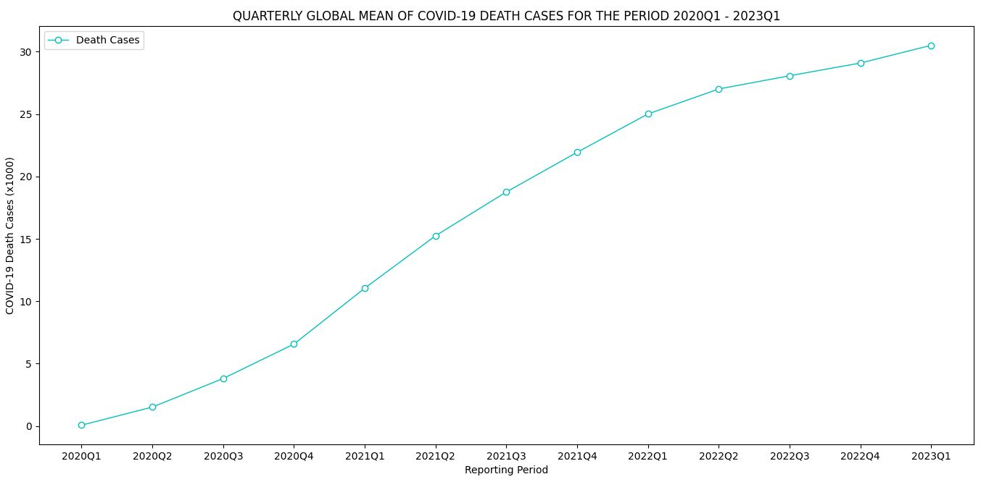
quarter | total_deaths
2020Q1 | 0.07
2020Q2 | 1.52
2020Q3 | 3.81
2020Q4 | 6.57
2021Q1 | 11.05
2021Q2 | 15.25
2021Q3 | 18.76
2021Q4 | 21.94
2022Q1 | 25.01
2022Q2 | 27.01
2022Q3 | 28.07
2022Q4 | 29.09
2023Q1 | 30.51
The mean global COVID-19 death cases have also continued to increase from 2020 to date.
From around 700 cases in the first quarter of 2020 to over 30,510 in the first quarter of 2023.

Slide 7
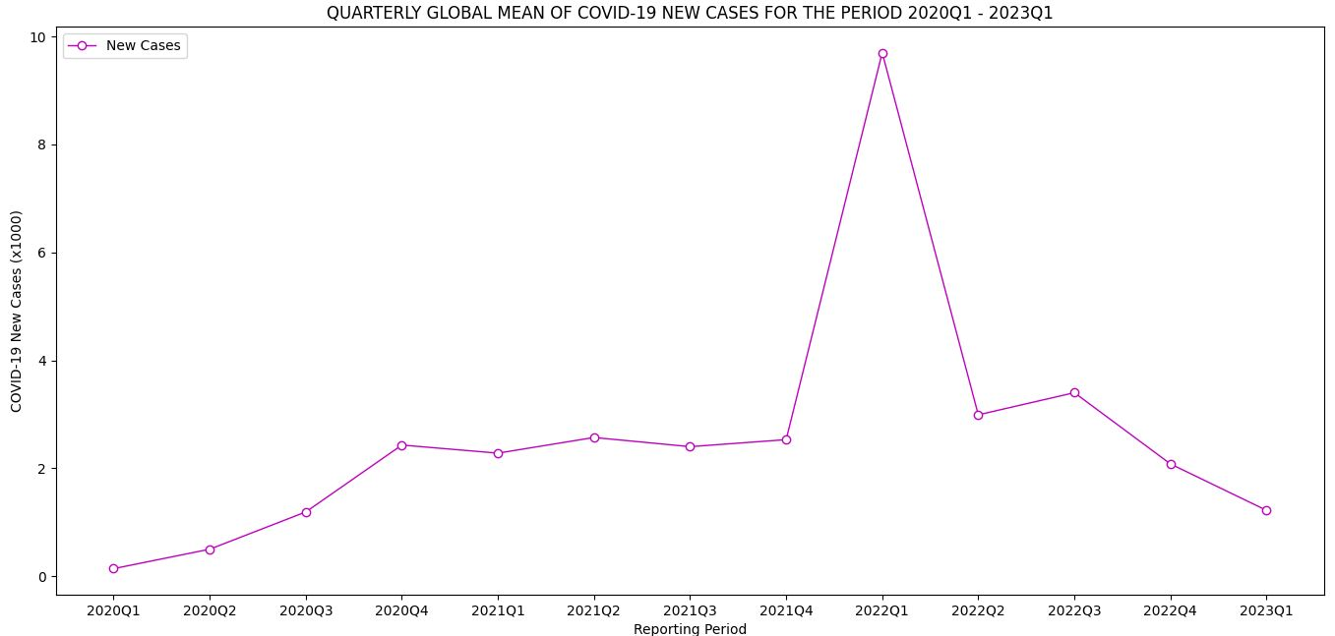
quarter | new_cases
2020Q1 | 0.14
2020Q2 | 0.5
2020Q3 | 1.19
2020Q4 | 2.43
2021Q1 | 2.28
2021Q2 | 2.57
2021Q3 | 2.4
2021Q4 | 2.53
2022Q1 | 9.7
2022Q2 | 2.99
2022Q3 | 3.4
2022Q4 | 2.08
2023Q1 | 1.22
The new COVID-19 cases showed an upward trend between 2020Q1 and 2022Q1 when it peaked at slightly over 9,700 cases.
However, since 2022Q1, the COVID-19 new cases have showed a downward trend.

Slide 8
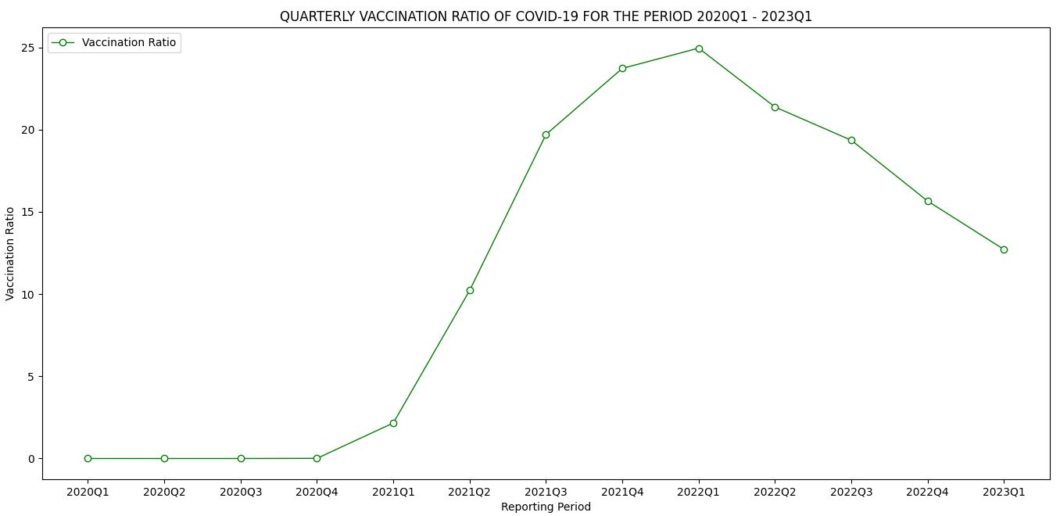
quarter | Vaccination ratio
2020Q1 | 0
2020Q2 | 0
2020Q3 | 0
2020Q4 | 0.01
2021Q1 | 2.16
2021Q2 | 10.22
2021Q3 | 19.7
2021Q4 | 23.72
2022Q1 | 24.95
2022Q2 | 21.37
2022Q3 | 19.35
2022Q4 | 15.65
2023Q1 | 12.71
The vaccination ratio plateaued for the first four quarters averaging 0.
However, between 2020Q1 and 2022Q4 there was an increase in vaccination peaking at 24.95% in 2022Q1.
From 2022Q1, the COVID-19 vaccination uptake took a nose-diving trend.
It is worth noting that the upward trend of the vaccination ratio is similar to the new cases peaking in 2022Q1.

Slide 9
CONCLUSION
The analysis showed that the COVID-19 new cases have increased globally over time.
The highest peak for most of the COVID-19 indicators was in 2022Q1.
There has been a declining trend there after.
The analysis also showed that the COVID-19 deaths have increased globally over time.
The analysis also showed that whereas there has been an increase in vaccination uptake, this might be a contributing factor in the decline in COVID-19 Cases.
However, the analysis did not show direct association to depict a cause-effect between C19 cases and vaccination.
The declining global indicators since 2022Q1 could be associated with several other factors, including improvements in health care management.

Slide 10
THANK YOU

